Slide 1
Coldfusion & PayPal Show me the Money!
Sidney Maestre
Developer Evangelist

Slide 2
Who am I?
Sidney Maestre
Developer Evangelist - X.commerce
ColdFusion Developer since version 3.1
Bay Area ColdFusion User Group
Flex and jQuery
Mobile Enthusiast - BAM! – Bay Area Mobile Meetup
Twitter - @SidneyAllen

Slide 3
What we’ll cover
Why PayPal
Developer Sandbox
Website Payment Standard
Express Checkout
Mobile Options
Recurring Payments
Instant Payment Notifications
Adaptive Payments
Q & A

Slide 4
Monetization online
Offers
Direct
e/m-commerce
Freemium
Pay as you Use
Free to use Pay for Services
Referrals
Premium Content
Digital Goods
Virtual Currency
Subscriptions
Advertizing
Indirect
Reselling
Donations
Pay for App

Slide 5
Why PayPal?
Trusted Brand
100 million active users
22 currencies supported
190 countries
Flexible APIs

Slide 6

PayPal Sandbox

Slide 7
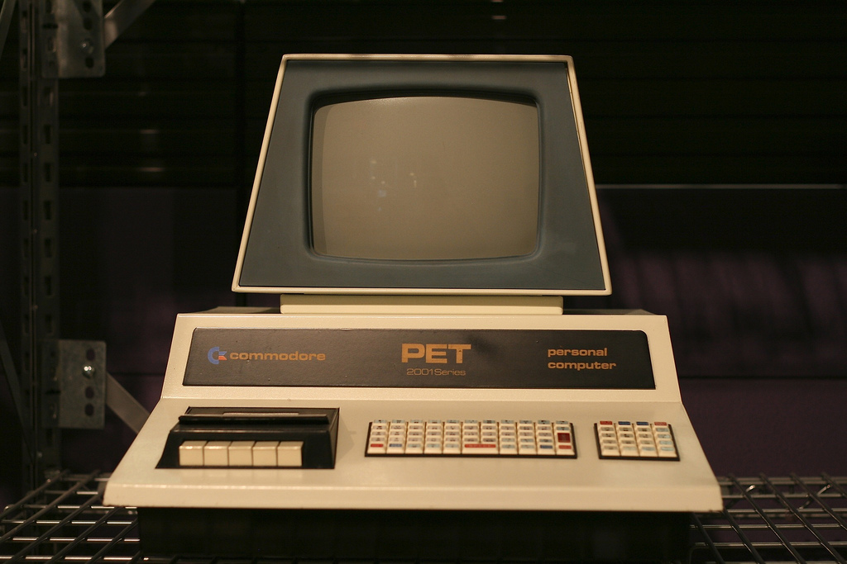
Website Payment Standard

Slide 8
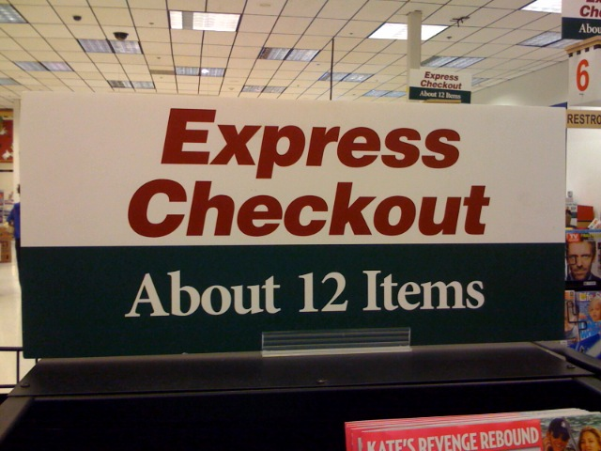
Express Checkout

Slide 9
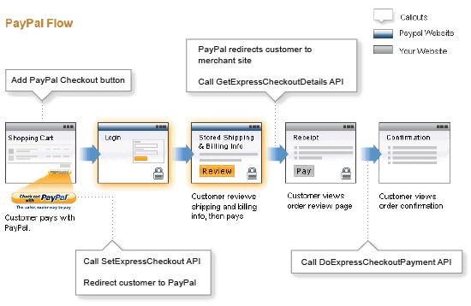
Express Checkout Flow

Slide 10
Let’s see some code

Slide 11
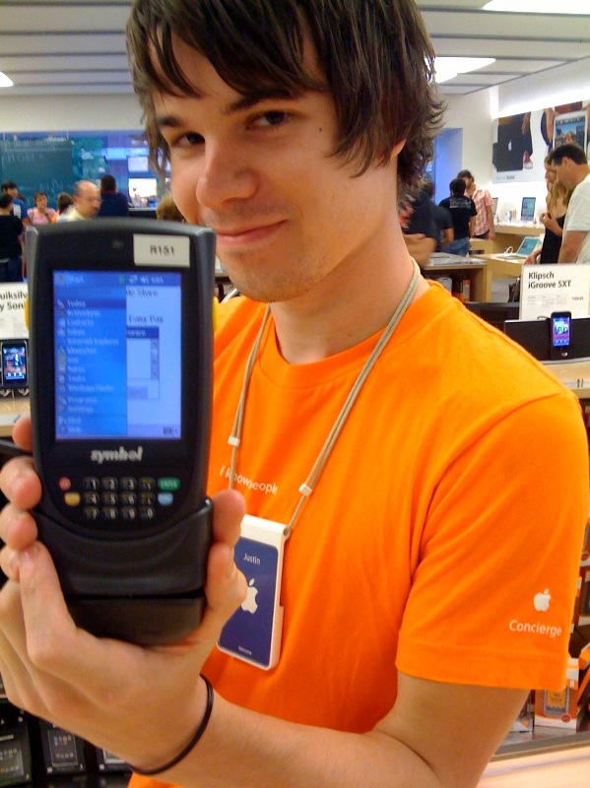
Mobile Express Checkout

Slide 12
Let’s see some code

Slide 13

Other Mobile Options

Slide 14
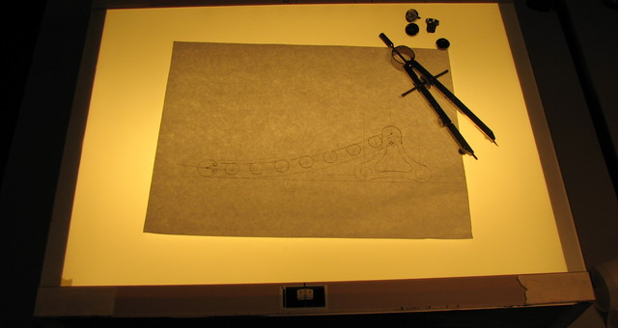
Express Checkout Embedded Flow

Slide 15
Let’s see some code

Slide 16
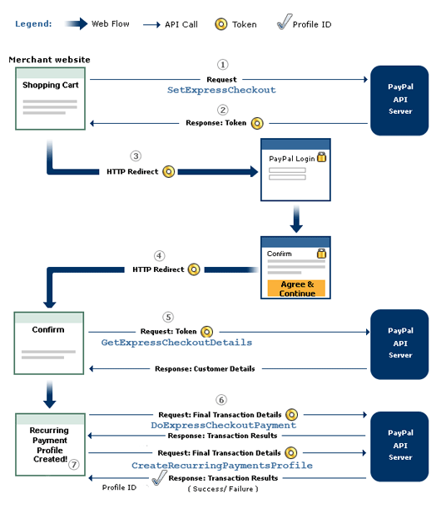
Express Checkout Recurring

Slide 17
Let’s see some code

Slide 18
CreateRecurringPaymentsProfile (continued)
Trial Period
TRIALBILLINGPERIOD
Day
Week
SemiMonth
Month
Year
TRIALBILLINGFREQUENCY
TRIALAMT
TRIALTOTALBILLINGCYCLES

Slide 19
CreateRecurringPaymentsProfile (continued)
Initial Payment
INITAMT
FAILEDINITAMTACTION
ContinueOnFailure
CancelOnFailure
IPN is called

Slide 20
GetRecurringPaymentsProfileDetails
Profile Status
Active, Pending, Expired, Suspended Cancelled
Next scheduled billing date
Number of cycles completed
Number of billing cycles remaining
Outstanding Balance
Number of failed billing cycles
Date of last successful payment received
Amount of last successful payment received

Slide 21
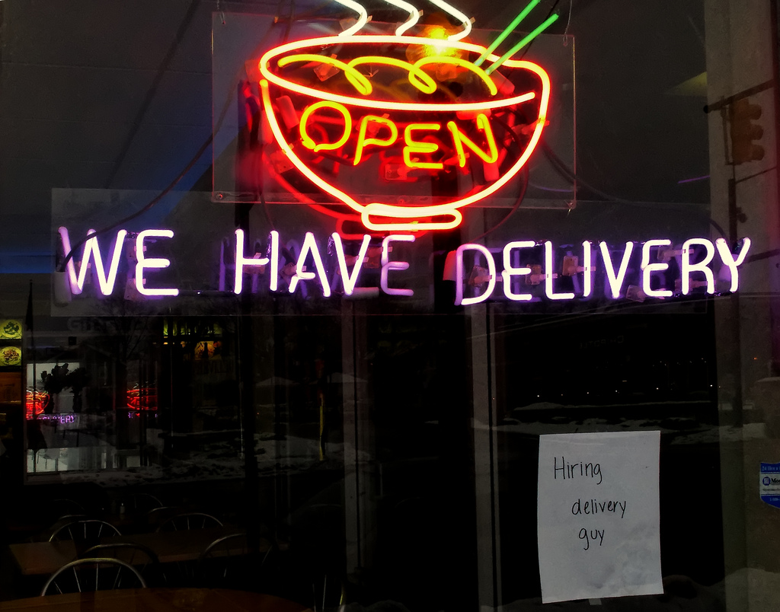
Instant Payment Notifications

Slide 22
Let’s see some code
http://www.crushitmobile.com/paypal/ipn.cfm

Slide 23

Questions?

Slide 24
Fin!

